Slide 1
What’s in the Cloud?
Kai Iyer

Slide 2
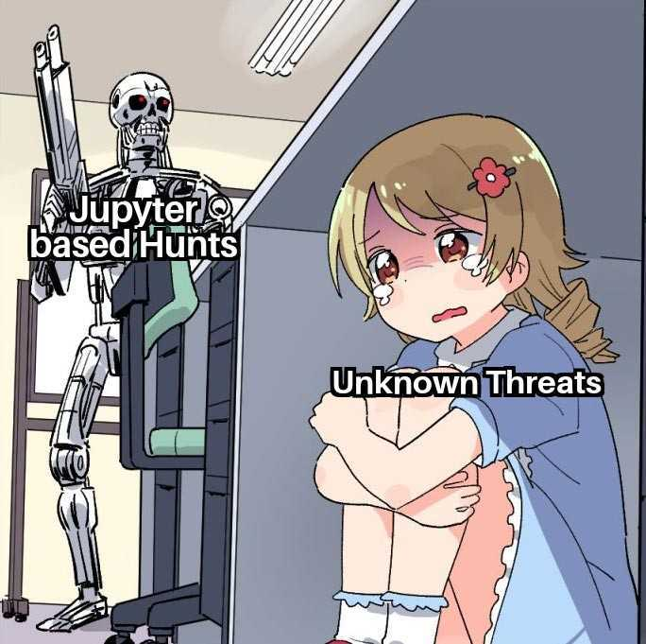
Agenda
whoami
Introduction
Limitations of traditional hunting
Deep Dive into O365 Logs
Diving into Jupyter
Takeaways
References

Slide 3
whoami /priv
Kai Iyer
Security Engineer, Amazon
Dev, Blog, Opensource, Privacy
Marathon, Anime & Manga
find me @kaiiyer

Slide 4
Disclaimer
The views, opinions, and content presented in this presentation are solely my own and do not reflect the views, policies, or positions of my employer or any affiliated organizations. This presentation is based on my personal research, experiences, and perspectives and should not be interpreted as an official statement from my employer.
For informational purposes only—use your own discretion when applying any insights shared.

Slide 5
Introduction
Threat hunting is an umbrella term for the techniques and tools organizations use to identify cyber threats
Traditional threat hunting was a manual investigation process relied on the expertise of Analyst, rather than automated tools, modern threat hunting depends on a combination of the two
Types:
Structured → Look for TTPs
Unstructured → Look for IoCs
Ad Hoc

Slide 6
Limitations of Traditional Hunting
Too much data Abundance of data hampers efficient threat analysis
Limited Scalability Challenging for analysts to manually identify relevant patterns and anomalies at large scale
Static Nature of Hunts Fixed rules or patterns are ineffective against dynamic and constantly evolving threats
Inability to Address Unknown Threats Unable to identifying threats not previously encountered

Slide 7
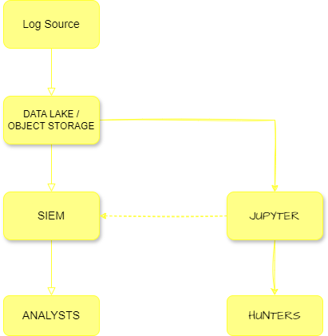
Data Flow
Log Source
AZURE DATA LAKE
SIEM
JUPYTER
ANALYSTS
HUNTERS

Slide 8

Deep Dive into O365 Logs
Office 365 Management Activity API schema
Common schema
Service-specific schema
File and Page Activities
FileAccessed: User or system account access a file on a SharePoint or OneDrive
FileDownloaded: User downloads a document from a site
Microsoft Viva Insights Activities
UserLoggedIn: A user signed in to their Microsoft 365 user account
UserLoggedOff: A user signed out of their Microsoft 365 user account
Photo by Nong on Unsplash
Notes:
event.outcome: success

Slide 9
Deep Dive into O365 Logs
Directory Administration Activities
Set domain authentication: Changed the domain authentication setting for your organization
Exchange Mailbox Activities
MailItemsAccessed: Messages were read or accessed in mailbox
New-InboxRule : User with access to mailbox created an inbox rule in the OWA
Set-InboxRule: User modified an inbox rule using the OWA
Identity
Microsoft Entra Audit – About changes applied to your tenant
Microsoft Entra Sign-ins – About sign-ins and how resources are used by users
Microsoft Entra Provisioning – Activities performed by the provisioning service
Photo by Nong on Unsplash
Notes:
Entra Audit – Information about changes applied to your tenant, such as users and group management or updates applied to your tenant’s resources
Entra Provisioning – Activities performed by the provisioning service, such as the creation of a group in ServiceNow or a user imported from Workday

Slide 10
Diving into Jupyter
Enough slides, show me the actual stuff!!!

Slide 11
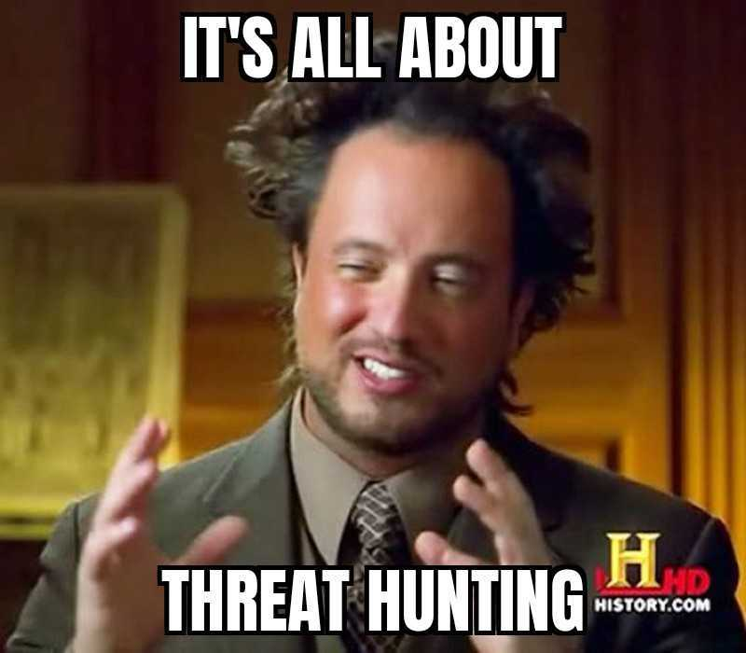
Takeaways
Challenges with traditional Threat Hunting
Jupyter based Hunting Approach
Enhancing Hunting with ML
Automating Threat Hunting Methodology
Ease of Adoption and Integration

Slide 12
Questions?

Slide 13
References
https://www.cloudflare.com/learning/security/glossary/what-is-threat-hunting/
https://www.microsoft.com/en-ca/security/business/security-101/what-is-cyber-threat-hunting
https://learn.microsoft.com/en-us/purview/audit-log-activities
https://learn.microsoft.com/en-us/office/office-365-management-api/office-365-management-activity-api-schema
https://learn.microsoft.com/en-us/entra/identity/monitoring-health/concept-sign-ins
https://research.splunk.com/detections/

Slide 14
Thank You

